Slide 1
Cost Estimation

Slide 2
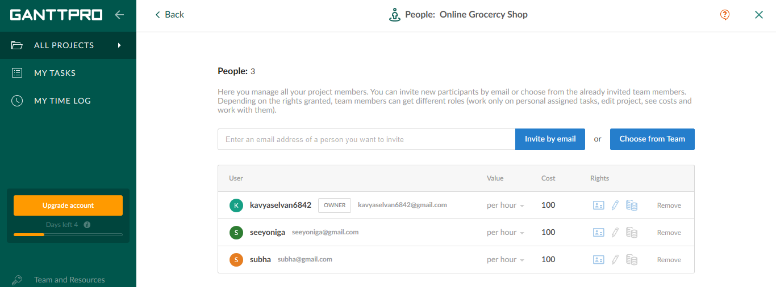
People

Slide 3
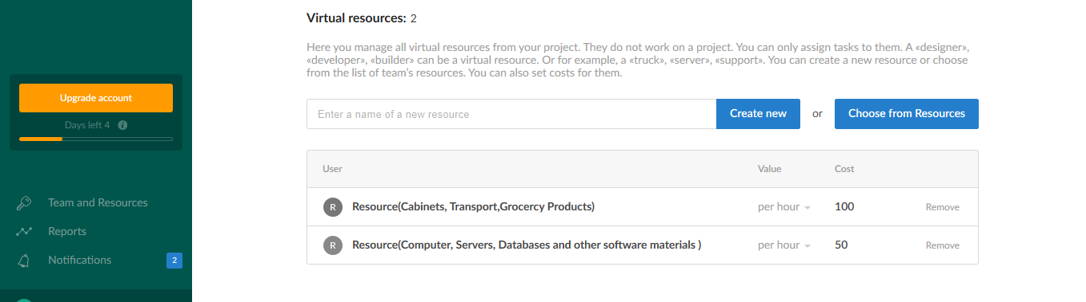
Resources

Slide 4
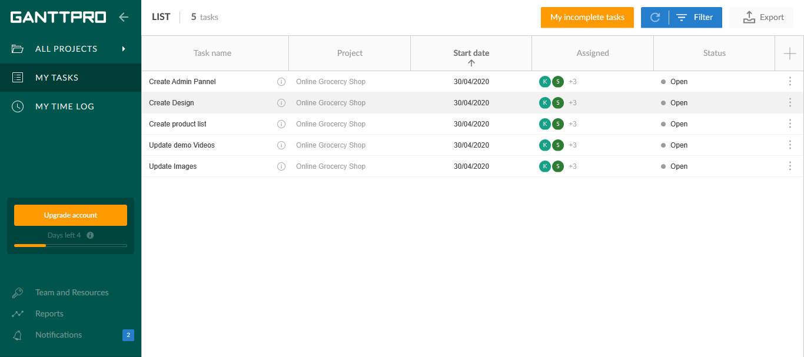
Tasks Assigned

Slide 5
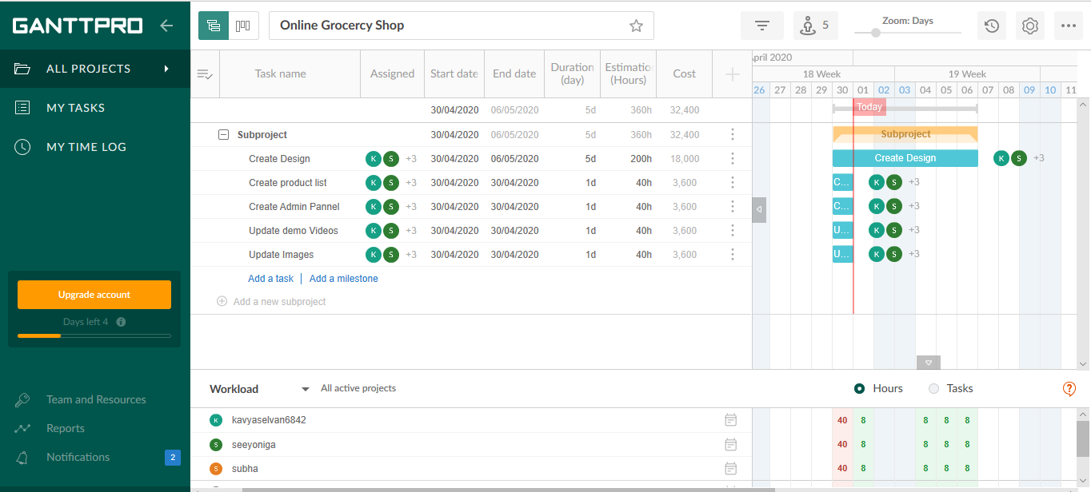
Final Cost Estimation

